Slide 1
IBM Informix 14.10 – What’s New?
Upgrade to higher performance, lower admin, and more robust analytics
Washington Are Informix User Group Meeting
Tuesday 3rd December 2019

Slide 2
Disclaimers
IBM’s statements regarding its plans, directions, and intent are subject to change or withdrawal without notice at IBM’s sole discretion.
Information regarding potential future products is intended to outline our general product direction and it should not be relied on in making a purchasing decision.
The information mentioned regarding potential future products is not a commitment, promise, or legal obligation to deliver any material, code or functionality. Information about potential future products may not be incorporated into any contract.
The development, release, and timing of any future features or functionality described for our products remains at our sole discretion.
Performance is based on measurements and projections using standard IBM benchmarks in a controlled environment. The actual throughput or performance that any user will experience will vary depending upon many factors, including considerations such as the amount of multiprogramming in the user’s job stream, the I/O configuration, the storage configuration, and the workload processed. Therefore, no assurance can be given that an individual user will achieve results similar to those stated here.

Slide 3
Agenda:
IBM Informix offering priorities
Major themes in IBM Informix 14.10
Key technical enhancements
Installation simplified
Security
InformixHQ
IBM Informix for Hybrid Cloud
Recap Q&A
3

Slide 4


















Where is IBM Informix used?
Retail
aerospace
Government
IoT
telecom
Credit transactions
education
Transport
Energy & utilities
IBM Informix is everywhere.
Notes:
Informix is a powerful yet invisible part of our daily lives.

Slide 5
What are the major themes in IBM Informix 14.10?
Faster
  Significant performance improvements for replication workloads and OLTP
Faster
InformixHQ
  New, fully supported, graphical administration tool
More Secure
Extensibility
and IoT
Enhancements
14.10
Cloud & Containerization
  New VPC pricing metric for easier license monitoring
  Docker Hub images
More Secure
  Provides higher security for encryption keys and Transport Layer Security
Cloud
InformixHQ
Enhancements for Usability, Administration, and Increased Uptime
  Customer RFEs implemented to include in-place alter improvements, renaming of indexes and constraints online, and Common Table Expressions
Extensibility and IoT
  ARMv8 support
  Enhanced timeseries granularity and spatial projection systems

Slide 6
What is IBM Informix 14.10?
14.10 is Faster!
Significant performance improvements in SDS, RSS and HDR secondary updates

Slide 7
Log replay performance improvements
Applying transactions to secondaries (RSS, SDS, HDR) has been optimized for performance under heavy load
  Performance tests show up to 5X increase in throughput when compared to Informix 12.10 benefiting all customers using these data availability solutions
  Similar improvement observed in crash recovery performance
New config parameters for performance tuning
  ‘onstat –g laq’ output shows replication latency and log replay rate

Slide 8
What is IBM Informix 14.10?
14.10 is Faster!
Significant performance improvements in SDS, RSS and HDR secondary updates - up to 5X increase
OLTP transaction performance - up to 10% faster than 12.10
Java UDR performance improvements - up to 40% faster
JSON and REST listener performance improvements - up to 2x faster
JDBC smart large object access speed improvements - more than 60%

Slide 9
What is IBM Informix 14.10?
14.10 is More Secure!
External keystore provides higher security for encryption keys
Integrated encryption for onbar and ontape backups
Notes:
Backup to Cloud Object store improvements - support V4 S3 authentication; IBM Cloud, AWS and soon to be other public clouds

Slide 10
Integrated encryption for your backups
Informix Backup and Restore utilities now have the capability to internally encrypt and decrypt your storage
  On-Bar, ontape, archecker, onlog utilities are supported
  dbspace, blobspace, smart blobspace and logical log backup data can be encrypted
Amazon AWS Key Management Service (KMS) is used for generation and storage of encryption keys for your backups
Encryption key is itself encrypted and stored together with the data
The same utilities also offer a simple way to encrypt and decrypt data using a locally provided static encryption key

Slide 11
What is IBM Informix 14.10?
14.10 is More Secure!
External keystore provides higher security for encryption keys
Integrated encryption for onbar and ontape backups
Latest encryption support
Smart Trigger audit trail
Notes:
Backup to Cloud Object store improvements - support V4 S3 authentication; IBM Cloud, AWS and soon to be other public clouds

Slide 12
What is IBM Informix 14.10?
14.10 has Customer requested Enhancements for Usability, Easier Administration, and Increased Uptime!
Common Table Expressions
Updated Unicode specification support
New commands to automate configuration of Enterprise Replication between two servers
One Informix binary with simple key based licensing to upgrade from edition to edition
Notes:
CTE – SQL standard, Improves readability of complex queries, Re-use CTE result-set multiple times in one query, Pipeline aggregations, Write powerful recursive query
By implementing the SQL standard CTE, application developers improve readability and maintenance of complex queries, able to re-use CTE result-set multiple times in one query, Pipeline aggregations and write powerful recursive queries. Complex queries can be divided into simple, ad hoc, logical building blocks. These simple blocks can then be used to build more complex, interim CTEs until the final result set is generated.
Support of current Unicode spec - Adding support for text characters that are new over the last 10 years; Asian characters, emojis to name a few.
Setting up Informix instance/or database level replication using Enterprise Replication - Single command that automates setting up of Enterprise Replication and data migration between two Informix server instances located either on-prem or in the cloud. This command automates tasks such as defining Enterprise Replication domain between the two servers, adding key columns for the tables, creating required storage spaces for the databases, copying database schema from source server to target serve, creating replicate definitions and finally synchronizing data between source and target server instances, all in a transactional, flexibly phased manner, with no downtime.

Slide 13
Installation Simplified for 14.10
“Base” image is Developer Edition – everyone starts with this!
Edition Installer used to “promote” to your entitled license
Installation process:
  Install the Developer Edition
  Run the edition installer
Why?
  Removes the need to completely reinstall the product for a new edition
  “promoting” or “demoting” an existing installation is a simple operation
  Solution goes through DevOps pipeline (dev, test, staging, production) without reinstalling Informix

Slide 14
What is IBM Informix 14.10?
14.10 has Customer requested Enhancements for Usability, Easier Administration, and Increased Uptime!
Common Table Expressions
Updated Unicode specification support
New commands to automate configuration of Enterprise Replication between two servers
One Informix binary with simple key based licensing to upgrade from edition to edition
JDBC 4.2 compliance
CLIENT_LABEL tags client name or program name for server-side monitoring
Improved uptime by changing from Slow ALTERS to in-place ALTERS
Notes:
CTE – SQL standard, Improves readability of complex queries, Re-use CTE result-set multiple times in one query, Pipeline aggregations, Write powerful recursive query
By implementing the SQL standard CTE, application developers improve readability and maintenance of complex queries, able to re-use CTE result-set multiple times in one query, Pipeline aggregations and write powerful recursive queries. Complex queries can be divided into simple, ad hoc, logical building blocks. These simple blocks can then be used to build more complex, interim CTEs until the final result set is generated.
Support of current Unicode spec - Adding support for text characters that are new over the last 10 years; Asian characters, emojis to name a few.
Setting up Informix instance/or database level replication using Enterprise Replication - Single command that automates setting up of Enterprise Replication and data migration between two Informix server instances located either on-prem or in the cloud. This command automates tasks such as defining Enterprise Replication domain between the two servers, adding key columns for the tables, creating required storage spaces for the databases, copying database schema from source server to target serve, creating replicate definitions and finally synchronizing data between source and target server instances, all in a transactional, flexibly phased manner, with no downtime.

Slide 15
14.10 Improves uptime!
Slow ALTERs are very expensive and so are generally avoided, but in 14.10:
  Many Slow ALTERs have been enhanced to be in-place ALTERs:
    Altering character type data from one character type to another
    Altering between INT, BIGINT, INT8, SERIAL, BIGSERIAL, SERIAL8 types
  With these in-place ALTER improvements some index rebuilds can be avoided
Altering Primary Key (PK) columns can require downtime when there are Check Constraints and Foreign Keys (FK), but in 14.10:
  Rebuilding the Check Constraints and FKs for PK ALTERs between many INT, BIGINT, INT8, SERIAL, BIGSERIAL, SERIAL8 types can be avoided and/or postponed
  Many new ALTER PK syntax additions have been added to Informix SQL

Slide 16
What is IBM Informix 14.10?
14.10 has InformixHQ!
  New web based administration and monitoring tool!
  Integrated with all Informix versions with full support
  Supports integration with modern IT infrastructure tools like Pager Duty, Twilo, email

Slide 17
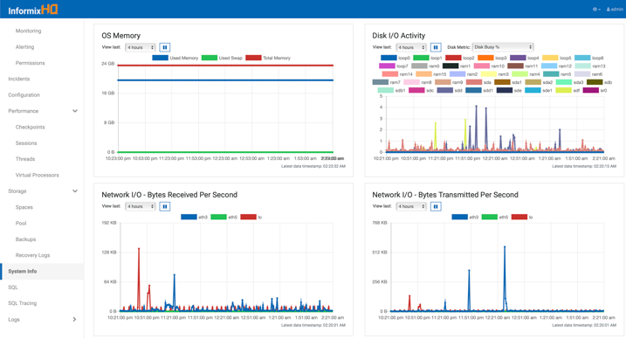
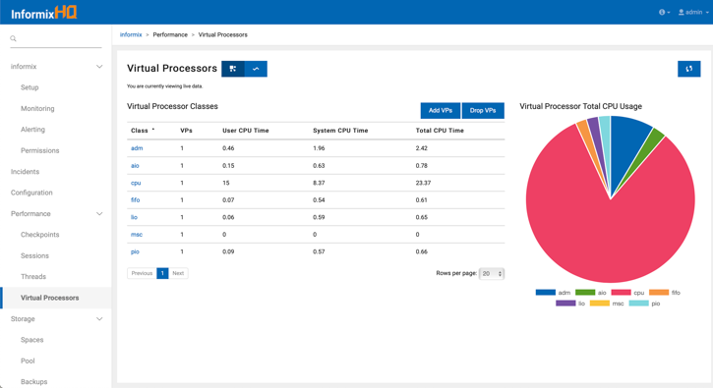
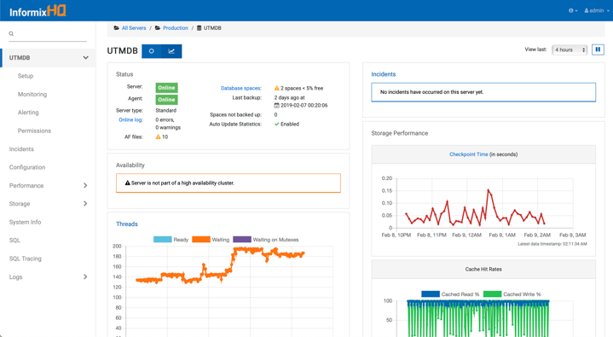
InformixHQ 1.0.0
Modern
Web UI
Scalable
Monitoring
Alerting
Administration
Next Gen
Front-End

Slide 18





InformixHQ Architecture
InformixHQ Server
Java 8 Jetty web server
Monitors/administers many database servers
Connects directly to database server for
  Live Data
  Administration
Connects to Monitoring agent for
  Monitored data
  Events
REST API
  For website, tools, 3rd parties
Monitoring Agent
Java 8 agent
Installed on each production database server
Requires only read access to system
Native command execution to gather OS statistics
User Interface (Web)
Redesigned for smoother experience
Modernized tech and design
Written in Angular 2 (Javascript)

Slide 19
What is IBM Informix 14.10?
14.10 has Improvements in Extensibility and IoT!
  ARMv8 support
  Count the number of objects in a given region in a given time range
  tstamp distinct type for TimeSeries usability
  Count and find missing readings for a given sensor or meter
  Support for geodetic and projections systems other than WGS 84
  Subsecond GPS readings (1/10 of a second timestamps)

Slide 20
What is IBM Informix 14.10?
Informix remains a great option for the Cloud!
  IBM Cloud continues to be a flexible and preferred option for Informix deployments – now updated with 14.10!
  IBM Cloud Private for Data (ICP4D) add-on Catalog presence (coming soon!)
  Informix in Hybrid Cloud

Slide 21
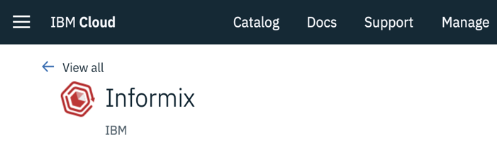
IBM Informix 14.10 in Hybrid Cloud
Private Cloud or On-premise Download
IBM Passport Advantage
IBM Partnerworld
IBM Trials and Downloads
Containerization
Docker Hub
  ibmcom/informix-developer-database
  ibmcom/informix-innovator-c
Public Cloud
IBM Cloud
  Choose a size – small, med, large, X-large

Slide 22
IBM Informix 14.10 for Developers
JDBC
  Java 8 – better performance
  JDBC 4.2 compliant – more APIs & flexibility
  Upgraded BSON library – performance and flexibility
ODBC
  Smart triggers support
  Core driver for Python, Node.js, Go, …
  github.com/openinformix
Docker Hub
  App Dev sandbox
docker pull ibmcom/informix-developer-sandbox

Slide 23
Thank You

